Slide 1

Maple Seed Funding Guide
PROJECT PRESENTATION
Helping Canadian small and medium businesses find the funding and support that fits them.
An independent, non-commercial learning project. Katherine Borges Sato · October 2026
Notes:
Welcome. This presentation walks through an independent learning project: a bilingual (English and French) guide that helps Canadian small and medium businesses find government and other support programs. I will cover the context, the problem and the numbers, the proposed solution, how the product is designed, the brand, and the next steps. Fill in your name on this slide before presenting.

Slide 2
Small and medium businesses are the backbone of Canada’s economy
CONTEXT
1.10M
98.2%
63.6%
47.2%
employer businesses in Canada, December 2024
of them are small businesses, with 1 to 99 employees
of private-sector jobs, about 8 million people, in 2024
of private-sector GDP in 2022: small 33.2% plus medium 14.0%
Source: Innovation, Science and Economic Development Canada, Key Small Business Statistics 2025
Notes:
Start with why this matters. Canada had about 1.1 million businesses with employees at the end of 2024, and 98.2 percent of them are small, meaning 1 to 99 employees. Small and medium businesses employ 63.6 percent of private-sector workers, around 8 million people, and generated close to half of private-sector GDP in 2022 (33.2 percent small plus 14.0 percent medium, which adds to 47.2). Anything that helps these businesses find support reaches a large part of the economy.

Slide 3
Support exists, but it comes from many places
THE LANDSCAPE
Federal government
grants, loans, tax credits
OUR PREMISE
Provinces and territories
vouchers, tax incentives
The information is public. Finding the right program, and knowing if you qualify, is the hard part.
Municipalities
local programs
Non-profit organizations
financing, mentorship
The federal Business Benefits Finder is published as open data under the Open Government Licence – Canada, which makes a project like this possible.
Private sector
banks, accelerators
Source: Business Benefits Finder dataset, Open Government portal (Open Government Licence – Canada)
Notes:
Support for businesses comes from five kinds of providers: federal, provincial and territorial governments, municipalities, non-profits and the private sector. These are exactly the categories we use as the first filter in the product. The premise of the project is that the information is public, but a business owner still has to work out which program fits and whether they qualify. This is our working premise, and the next slide shows what national surveys say about it.

Slide 4
Few small businesses use government financing, and awareness of programs is limited
THE PROBLEM
1%
79%
16%
34%
of small businesses requested government financing in 2024, against 24% for trade credit and 9% for debt
of those government financing requests were approved, so the programs do say yes
of businesses that did not use the Canada Small Business Financing Program knew it existed (34% of borrowers)
of those same non-users were aware of any federal financing support program (43% of borrowers)
Sources: ISED Credit Conditions Survey 2024 (1,825 small businesses); ISED Borrower Awareness and Satisfaction Study 2023–2024
Notes:
These are the numbers that back the problem. In the 2024 Credit Conditions Survey, only 1 percent of small businesses requested government financing, compared with 24 percent for trade credit and 9 percent for debt financing. When they did ask, 79 percent were approved, so the issue is not that programs refuse everyone. On awareness, the 2023-2024 Borrower Awareness and Satisfaction Study found that only 16 percent of businesses that had not used the Canada Small Business Financing Program were aware of it, and 34 percent were aware of any federal financing support program. Be careful with the wording: the 34 and 43 percent figures are about awareness of federal financing programs among non-users and among borrowers of that one program, not about all businesses.

Slide 5


What the data supports, and what it does not show yet
READING THE NUMBERS HONESTLY
It supports
It does not show yet
Programs exist at scale, and 79% of government financing requests are approved.
Awareness of specific programs is low: 16% to 34%, depending on the group.
The audience is very large: 1.10 million employer businesses.
79% of small businesses said they did not need financing in 2024.
Only 1% named being unaware of financing sources as their main reason for not seeking it.
No national figure tells us how hard programs are to find or understand.
The opportunity is for owners who do need support. This project assumes it and does not claim to have measured it.
Notes:
This slide keeps the project credible. The surveys support parts of the story, but not all of it. Most small businesses said they did not need financing, and very few said that not knowing about sources was their main reason for not applying. That means the opportunity is not every business: it is the owners who do need support and have trouble finding or understanding it. We have no national statistic for how hard programs are to find, so this project treats that as an assumption, not a finding. Informal feedback from a few people could help, but it is not a formal study.

Slide 6
What a business owner may be thinking
THE OWNER’S PAIN: HYPOTHESES TO TEST
1
“I do not know which programs exist for my business.”
2
“I cannot tell whether I qualify.”
3
“Every program site uses its own words and steps.”
4
“I do not know what to prepare before applying.”
5
“A wrong guess costs time I do not have.”
Hypotheses from the project’s design thinking, not survey results. They should be checked with feedback when possible.
Notes:
These five statements are the pain points the product is designed around. I want to be clear that they are hypotheses, not findings: they come from the design work on this project and have not been tested with real business owners. They guide the design, and feedback from a few people, even informal, would be a useful check.

Slide 7



One place to find, understand and prepare
THE PROPOSAL
Find
Understand
Prepare
Search by Filters. A directory of programs you can narrow by provider, type of support, goal, sector and province.
Find My Support. Five short questions, then programs sorted into match, maybe and not a match, with the reason for each.
My list and PDF. Save programs, tick off a checklist of what to prepare, and download a report to share with an accountant.
Every program links to its official website. The guide never applies on behalf of the business.
Notes:
The proposal is a bilingual guide in three parts. Find: a searchable directory with filters. Understand: a short guided assistant that checks a business profile against each program’s published criteria and explains the result. Prepare: a saved list, a checklist and a PDF report. It points to the official website for every program and never applies for anyone.

Slide 8
Six principles behind the product
THE IDEA
Rules, not AI
Always explained
Honest
Matching follows each program’s published criteria. No black box.
Every result says why: what fits, what to confirm, what does not.
No promises and no advice. Every program links to its official site.
Private by design
Bilingual
Independent
Nothing is saved unless you choose. Built with PIPEDA and Québec’s Law 25 in mind.
English (Canada) and French (Québec) from the first version.
A non-commercial learning project, not a government website.
Privacy and legal points are design guidance, not legal advice. They need review before a public launch.
Notes:
These six principles shape every screen. Matching is rule-based, which keeps it explainable and cheap to build. Each result says why. The product never promises eligibility and always sends people to the official source. Privacy was designed in from the start, with Canadian federal and Québec rules in mind, but it still needs legal review before a public launch. It is bilingual from day one, and it is clearly an independent learning project.

Slide 9

How the matching works
STRUCTURE
1
2
3
4
Your profile
Program rules
Check
Result
Province, sector, size, goal and structure.
Published criteria for each program, entered as simple rules.
Each criterion is marked fits, to confirm or does not fit.
Match, maybe or not a match, with the reasons.
Data source. The Business Benefits Finder, an open dataset from the federal government.
Quality limit. Results are only as good as the rules entered and kept up to date.
In the prototype the rules cover example programs. Loading and maintaining real rules is part of the next steps.
Notes:
This is the structure of the matching. The business answers five questions. Each program has a small rule sheet with its published criteria. The system checks each criterion and marks it as fits, to confirm, or does not fit. A program with any criterion that does not fit goes to not a match; one with only unclear items goes to maybe; the rest are matches. There is no machine learning involved. The honest limit is that the results are only as good as the rules, so keeping real program data accurate and current is the main piece of work still ahead.

Slide 10
What this project shows as software engineering
ENGINEERING
Data pipeline
Rule engine
Turn an open government spreadsheet into clean, structured program records.
Programs as data, rules as code. Small testable functions and results that explain themselves.
Product and UX
Delivery
User flows, a bilingual interface, accessibility and privacy by design.
Version control, documentation and a deployed demo.
Planned stack: [add your choice here]
Notes:
This slide frames the project for a software engineering portfolio. The product idea is the context, and the engineering work is in four areas: a data pipeline that cleans an open government file into structured records, a rule engine where programs are data and rules are small, testable functions with explainable results, the product and UX side with a bilingual interface, accessibility and privacy by design, and delivery with version control, documentation and a deployed demo. Replace the placeholder at the bottom with the stack you choose.

Slide 11
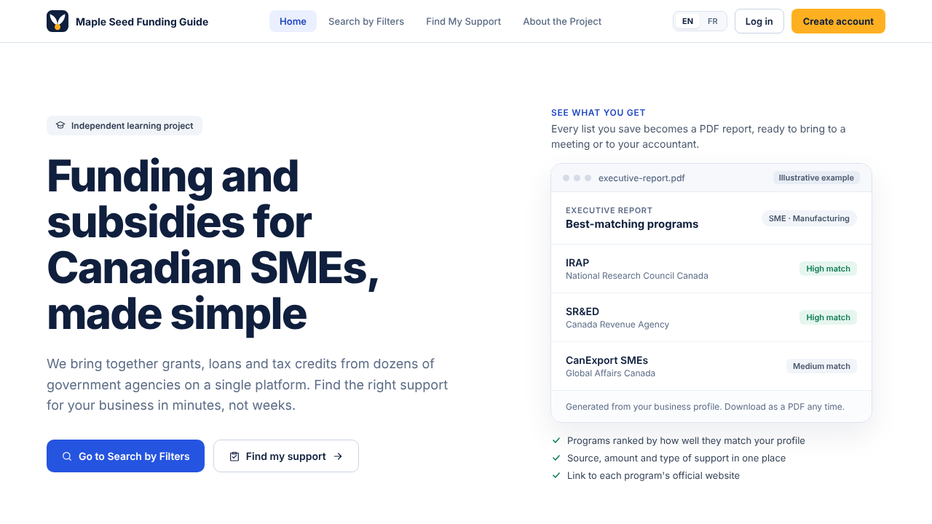
The promise in one screen
DESIGN · HOME
A plain promise: funding and subsidies for Canadian SMEs, made simple.
Two clear paths: browse with filters, or be guided.
A sample report shows what the user gets.
Prototype screen with example data.
Notes:
This is the home page. The headline says what the product does in one line, there are two paths for two types of users, those who want to browse and those who want guidance, and a sample PDF report shows the outcome. A visible note says this is an independent learning project, so nobody confuses it with an official service.

Slide 12
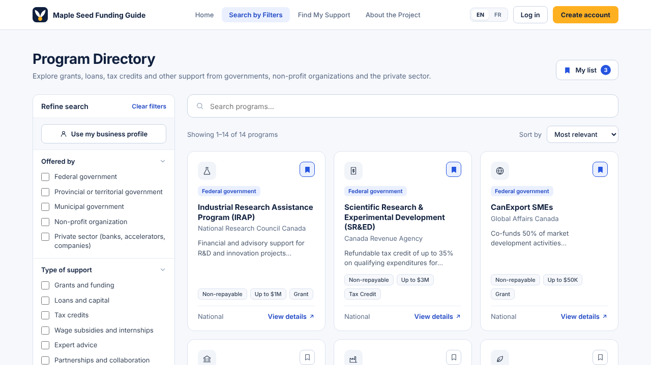
A directory you can narrow down
DESIGN · SEARCH BY FILTERS
Filters by provider, type of support, goal, sector, province, size and more.
Each card shows the provider, type, amount and region.
One click saves a program to My list.
Prototype screen with example data.
Notes:
This is the directory. The filters on the left follow the categories in the open government data. Each card gives the essentials: who offers it, whether it is repayable, how much, and where it applies. The bookmark saves a program to the user’s list. The programs shown are examples for the prototype.

Slide 13
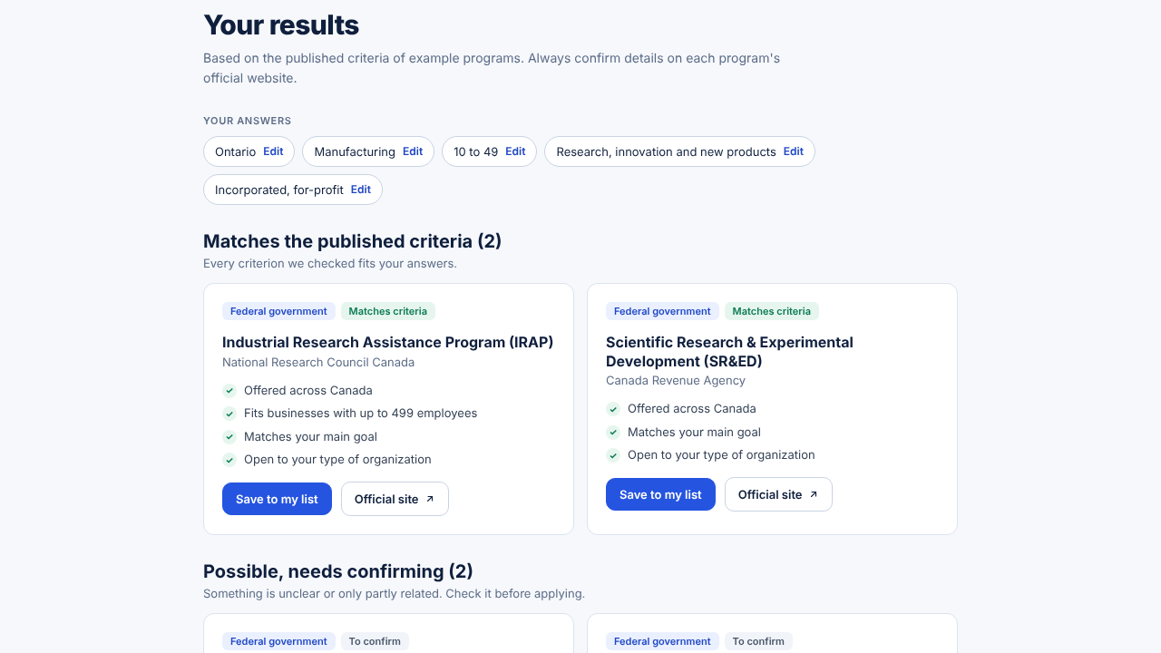
Guided matching, with the reasons shown
DESIGN · FIND MY SUPPORT
Five questions, about two minutes, no account needed.
Programs grouped as match, maybe, and probably not.
Each card lists what fits and what to confirm.
Prototype screen with example programs and simplified rules. Not eligibility advice.
Notes:
This is the guided assistant and the part that makes the product different from a plain directory. After five questions, the user sees programs grouped into matches, possible matches that need confirming, and probable non-matches, each with the reasons. Below the results there is a short checklist of what to prepare and options to download a PDF or save the results. The screen is the prototype with example programs and simplified rules, and it says so on the page.

Slide 14
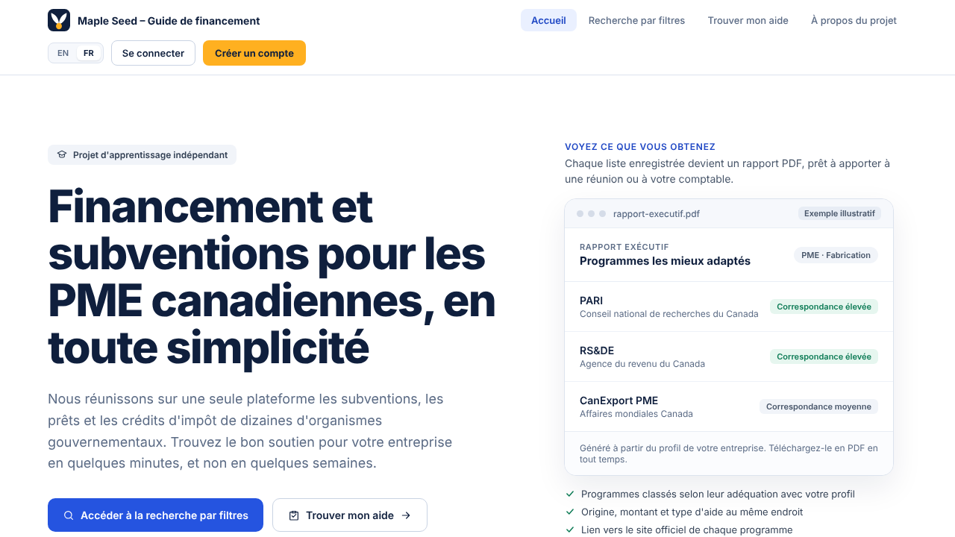
Bilingual and privacy-aware from the start
DESIGN · LANGUAGE AND PRIVACY
Every screen exists in English (Canada) and French (Québec).
On French pages the descriptive part of the name is in French.
Consent at sign-up, a plain-language privacy notice, and a way to delete everything.
Designed with PIPEDA, Québec’s Law 25 and the Charter of the French Language in mind. Needs legal review before launch.
Notes:
The same product exists in English for Canada and in French for Québec. In the French version the descriptive part of the name is in French, because the Charter of the French Language asks for it. Privacy is part of the design: consent when you create an account, a privacy notice in plain language, and a way to delete your data. This was designed with PIPEDA and Québec’s Law 25 in mind, and it still needs a legal review before any public launch.

Slide 15
Maple Seed Funding Guide
NAME AND SYMBOL
Maple says Canadian. Seed says a small start that can grow.
The symbol is a pair of maple seed wings joined at one seed: businesses and programs meeting at a match.
It is Canadian without the flag’s maple leaf, which is an official national symbol.
“Funding guide” says what the site is, without promising money.
Availability of the name, domain and logo is not yet verified. A brand and logo record documents the full reasoning.
Notes:
The name has two halves. Maple says Canadian, seed says a small start that can grow, which describes the businesses the product is for. The symbol is the winged seed of a maple, shown as a pair of wings joined at one seed, which also stands for businesses and programs meeting at a match. We avoided the maple leaf from the flag because it is an official national symbol and a cliché. The words funding guide say what the site is without suggesting it hands out money. I have not yet verified whether the name, domain or logo are available, which is an open item.

Slide 16

Eleven rounds of ideas, one symbol
HOW WE CHOSE IT
Paths, graphs, handshakes, magnifiers, lanterns, clarity, plants and a Canadian leaf came first. The maple seed pair won on clarity and meaning.
Notes:
The symbol was not the first idea. We explored eleven rounds: paths and bridges, graphs and connected points, handshakes, magnifiers and lanterns, clarity, plants and gardening, and a Canadian leaf. This slide shows a sample from those rounds. The pair of maple seed wings was chosen because it is recognisable, works small, is Canadian without the flag leaf, and means two sides meeting at one point. A risk we noted is that it can read as rabbit ears or a letter V at small sizes, so it should be tested with people who have not seen it.

Slide 17
From design prototype to a working portfolio project
NEXT STEPS
Done
Next: build the MVP
Then: polish and share
Screens in English and French
Guided matching prototype
Brand and logo record
Legal and privacy checklist
Import program data from the Business Benefits Finder file
Write rules for a first set of programs
Build the matching engine with unit tests
Saved list and PDF report
Accessibility checks (WCAG)
Deployed demo and README
Case study for the portfolio
Informal feedback from a few people
Scope stays small on purpose: a working, well-documented MVP matters more than covering every program.
Notes:
The design, the prototype and the brand are done. The next phase is to build a small working version: import the program data from the open government file, write matching rules for a first set of programs, build the matching engine with unit tests, and add the saved list and the PDF report. After that: accessibility checks, a deployed demo with a clear README, a case study for the portfolio, and informal feedback from a few people. The scope is deliberately small. A working, well-documented MVP is worth more than covering every program.

Slide 18
Risks and how they are handled
RISKS
Risk | How it is handled
Program data is wrong or old | The demo uses example data and every program links to its official page
Looks like a government service | Independent notice on every page, no flag leaf, no “Canada” in the name
Name already in use | Check domain and trademark before making the project public
Handling personal data | The demo stores no real personal data; privacy is reviewed before any real use
Scope grows too large | Keep the MVP small: a few programs, done well
The project is a portfolio demo, not a service. These notes are not a legal or financial assessment.
Notes:
These are the main risks for a portfolio project. Data accuracy is handled by using example data in the demo and linking to the official page of every program. The independent notice and the choice of name and symbol reduce the risk of looking like a government service. The name has to be checked before the project is made public. The demo stores no real personal data, and privacy would need a proper review before any real use. The last risk is scope, which is handled by keeping the MVP small.

Slide 19
One place to find, understand and prepare for the support that fits your business.
IN ONE SENTENCE
Thank you. Questions and feedback are welcome.
Katherine Borges Sato · katherine.borges.sato@gmail.com
Notes:
Close with the one sentence: one place to find, understand and prepare for the support that fits your business. Then invite questions and feedback. This is an independent, non-commercial learning project, and feedback from business owners and advisors is the most useful thing it can get. Fill in your name and contact email on this slide.

Slide 20
Where the numbers come from
SOURCES
Key Small Business Statistics 2025
ISED. Business counts to December 2024, employment 2024, GDP shares 2022. The 47.2% is the small (33.2%) plus medium (14.0%) share.
Credit Conditions Survey 2024
ISED. 1,825 small businesses surveyed January to April 2025, covering financing sought in 2024.
Borrower Awareness and Satisfaction Study 2023–2024
ISED, Canada Small Business Financing Program. Fieldwork November 2023 to January 2024.
Business Benefits Finder dataset
Open Government portal. Published under the Open Government Licence – Canada.
Figures were read from these pages in October 2026 and should be rechecked before the deck is reused.
Notes:
All the statistics in the deck come from these four federal sources. The 47.2 percent GDP figure is my sum of two shares the source reports separately. The prototype screens use example programs, not the full dataset.

